Slide 1


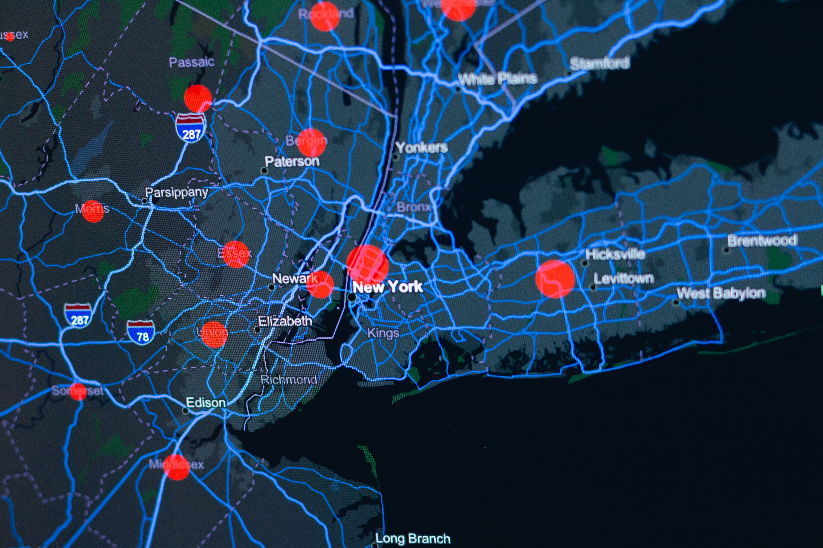

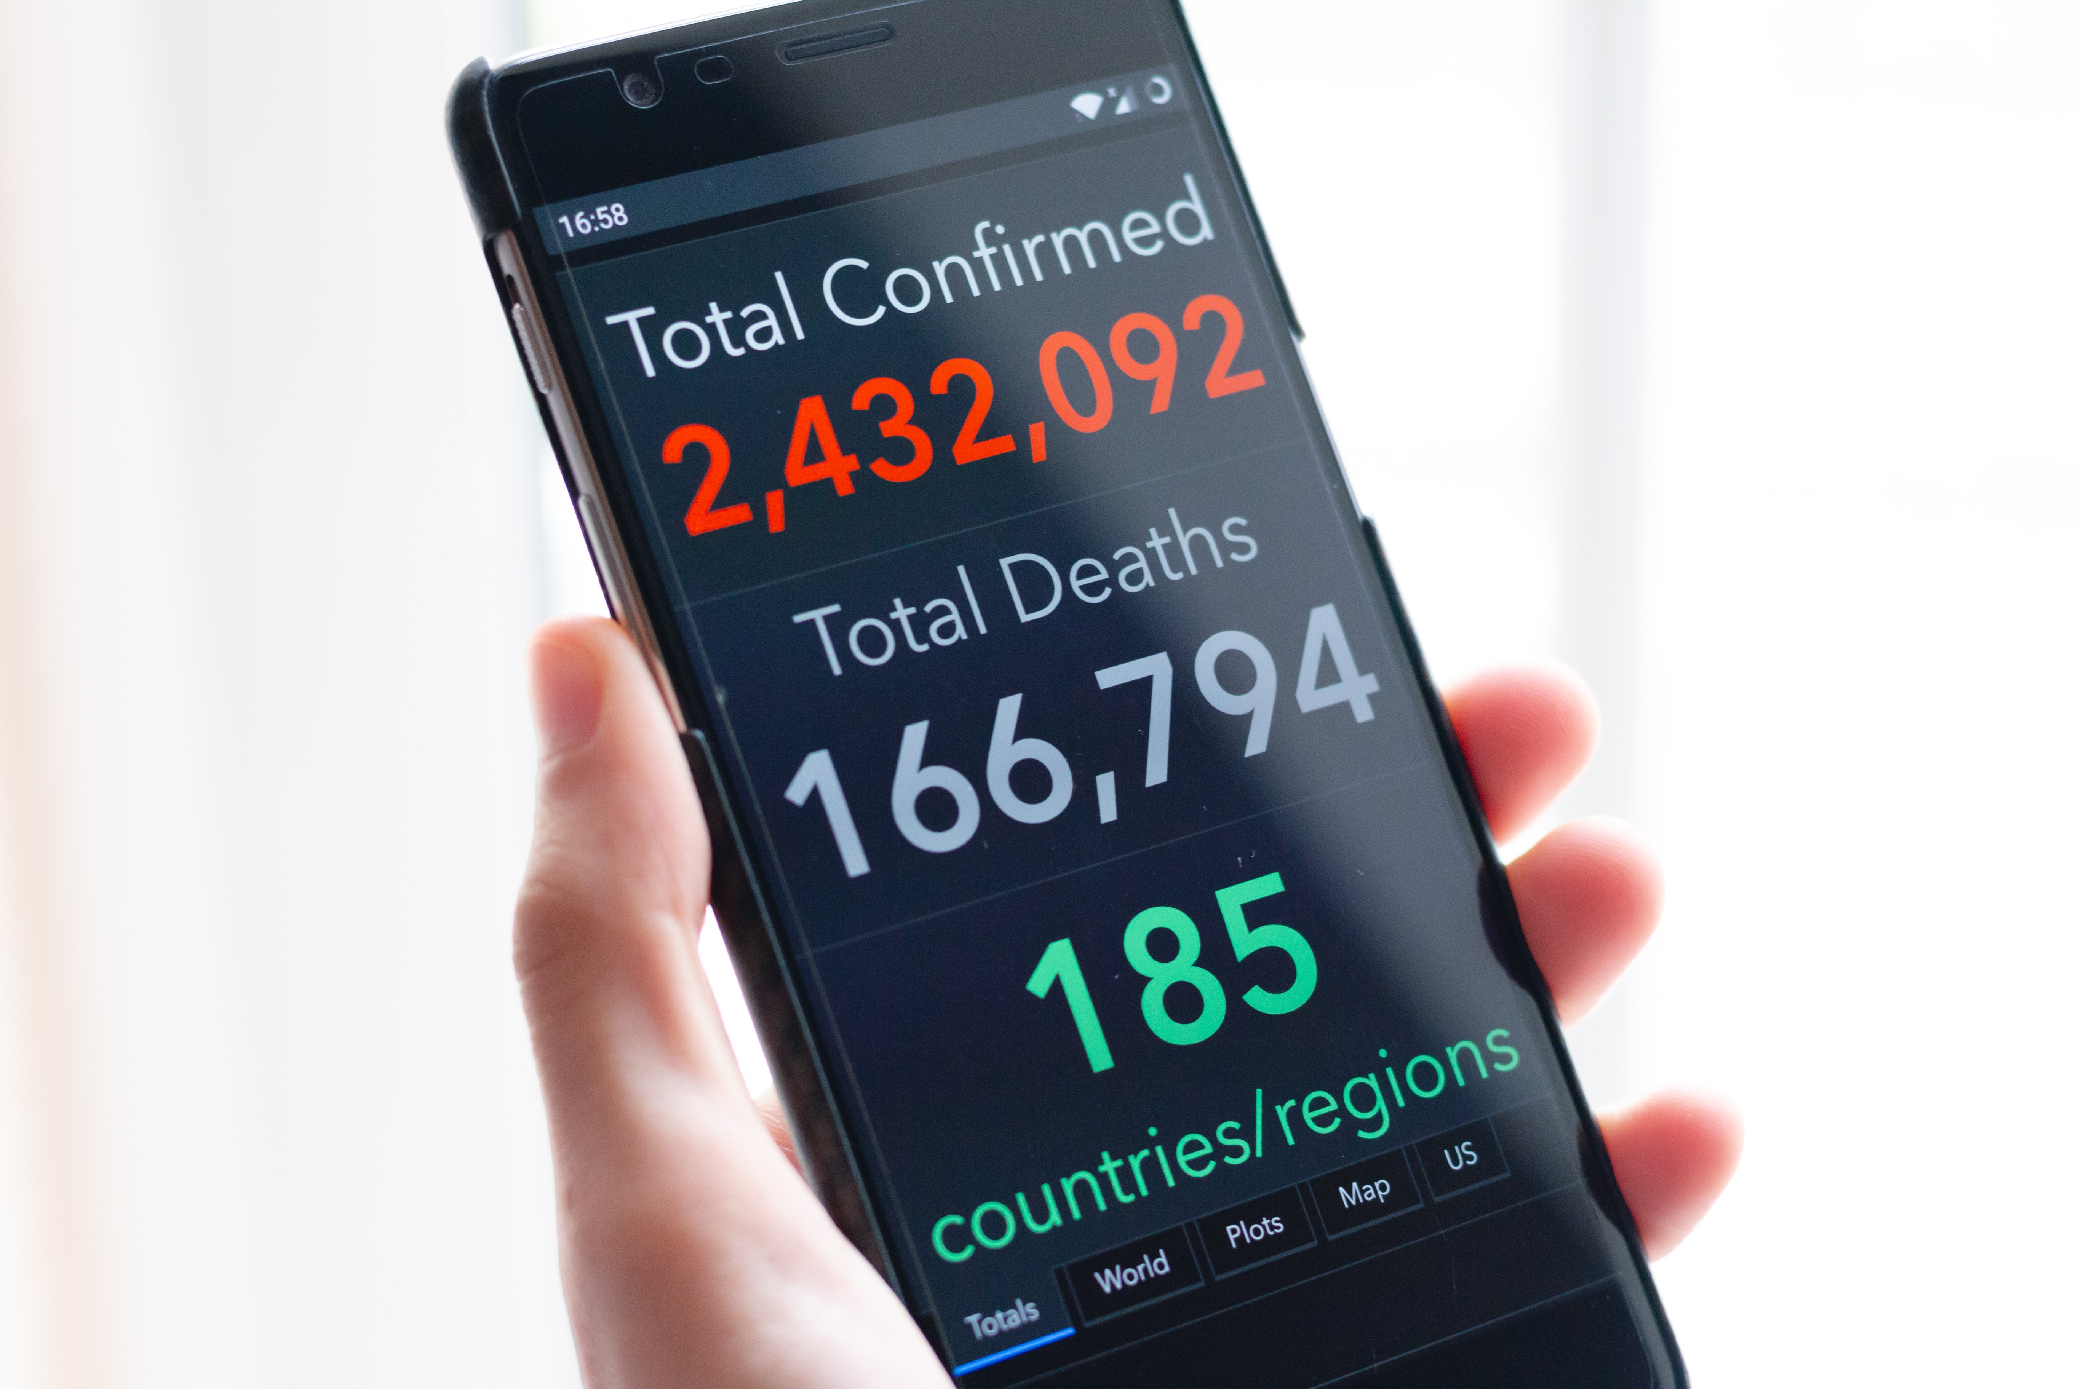

Data Science.
Data Science
Presenter: Udeme Billy

Slide 2
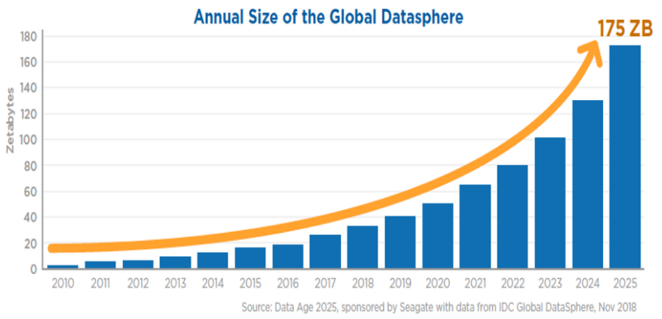
Data Science is the sexiest job of the 21st century. Harvard Business, 2012
... Estimates suggest that the total amount of data created, captured, copied, and consumed in the world is likely to touch 149 zettabytes by 2024, compared to just the two zettabytes generated in 2010.

Slide 3

What is included in the course content
Re-introduction Data Structure
Image Processing
Time Series
Data Visualisation
Deep Learning
Neural Networks
Machine Learning, Regression, Classification
Streamlit.

Slide 4

Stock Price Application
Data set was gotten from Wikipedia 'https://en.wikipedia.org/wiki/List_of_S%26P_500_companies'
Packages used were Pandas, Matplotlib, yfinance, base64, Streamlit.
Services Provided
You will be able to select companies from a pool of sectors and check their change in price over time and how to check Overall performance.
Display the information on a user interphase.
Recommendation on when and where we should invest.
Accessing the information in excel.

Slide 5
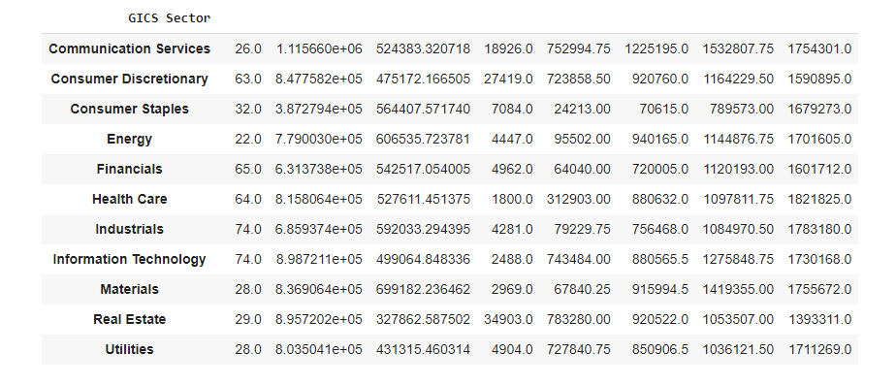
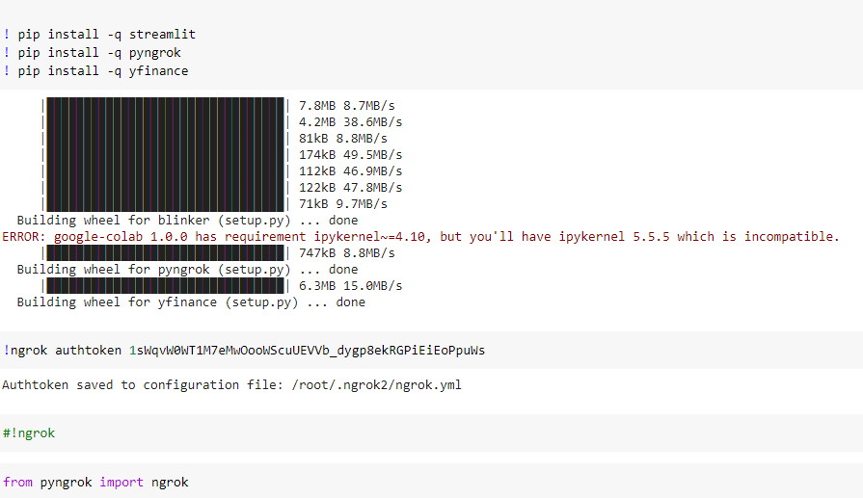

Slide 6
Thank you / Danke!
Udeme Billy
For
Spring 2021, Data Science class.

